Slide 1
HTML Tables

Slide 2
Overview
In this section you will get to know how to work around table in HTML to structure tabular data
Requirement
A knowledge of basic HTML, text editor/IDE and a web browser

Slide 3
Why table?
Tables allows you to quickly and easily look up values that indicate some kind of connection between different types of data, for example a person and their age, or a day of the week.
The lecture timetable of the university is an example of a table.
Without the timetable, it will be very hard and nearly impossible for a student to accurately lookup his/her lectures.

Slide 4
Defining an HTML Table
An HTML table is defined with the <table> tag. Each table row is defined with the <tr> tag. A table header is defined with the <th> tag. By default, table headings are bold and centered. A table data/cell is defined with the <td> tag.

Slide 5
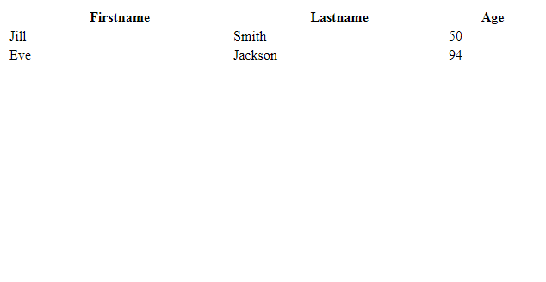
Listing 2
First example
Output
If you notice, the output seemed structured, but without borders
<table style="width:100%">
<tr>
<th>Firstname</th>
<th>Lastname</th>
<th>Age</th>
</tr>
<tr>
<td>Jill</td>
<td>Smith</td>
<td>50</td>
</tr>
<tr>
<td>Eve</td>
<td>Jackson</td>
<td>94</td>
</tr>
</table>

Slide 6
HTML <style> element
The html <style> element is used to define style rules internal to an html document. The <style> element has both opening and closing tag and is usually placed within the head section of an html document.
Syntax of a style rule
selector {
property: value;
}
Note: The <td> elements are the data containers of the table. They can contain all sorts of HTML elements; text, images, lists, other tables, etc.

Slide 7
Syntax of a style rule explained
selector : This is a valid css selector, for this part of the course, the selector are names of html elements and multiple selectors are separated with commas.
property: This is a valid css property
value: This is a valid value for the specified css property
multiple property: value pairs are separated by semicolon

Slide 8
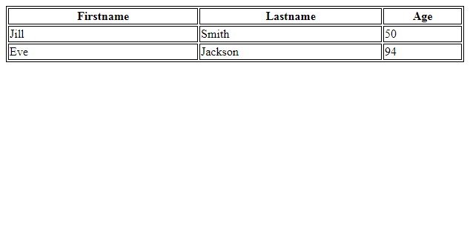
HTML table – adding border
Output
A bit clear but the border aren’t collapsed
If you do not specify a border for the table, it will be displayed without borders.
A border is set using the CSS border property:
Add the following style rule to listing 2
table, th, td {
border: 1px solid black;
}
Remember to define borders for both the table and the table cells.

Slide 9
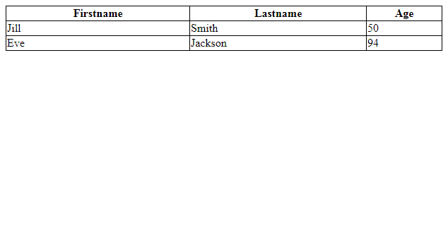
HTML table – collapsed border
Output
The result, is a table with collapsed border
If you want the borders to collapse into one border, add the CSS border-collapse property:
To the table
Add the following style rule to listing 2
table {
border-collapse: collapse;
}

Slide 10
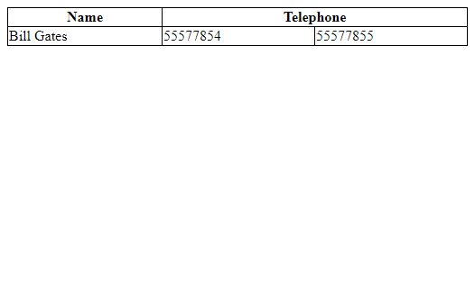
HTML Table - Cells that Span Many Columns
Output
Note: All attribute that applies to <th> also applies to <td>
To make a cell span more than one column, use the colspan attribute:
<table style="width:100%">
<tr>
<th>Name</th>
<th colspan="2">Telephone</th>
</tr>
<tr>
<td>Bill Gates</td>
<td>55577854</td>
<td>55577855</td>
</tr>
</table>

Slide 11
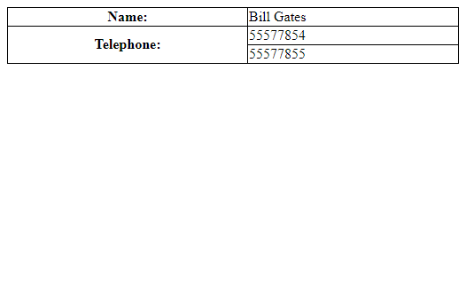
HTML Table - Cells that Span Many Rows
Output
Note: All attribute that applies to <td> also applies to <th>
To make a cell span more than one row, use the rowspan attribute:
<table style="width:100%">
<tr>
<th>Name:</th>
<td>Bill Gates</td>
</tr>
<tr>
<th rowspan="2">Telephone:</th>
<td>55577854</td>
</tr>
<tr>
<td>55577855</td>
</tr>
</table>

Slide 12
Task
Using the knowledge gained and any text editor of your choice, Create a html page containing the table shown in the next page . Use https://developer.mozilla.org/en-US/docs/Learn/HTML/Tables/Basics as reference while completing the task. Good Luck.

Slide 13
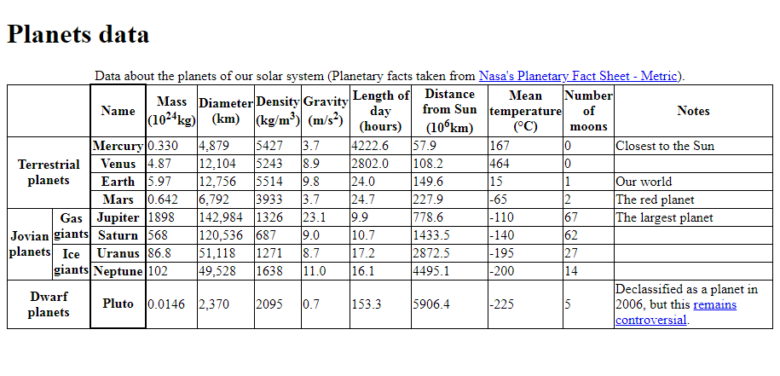

Slide 14
Thank You!

